Slide 1
Internet of Things Practical Session
- Vikas Yadav

Slide 2
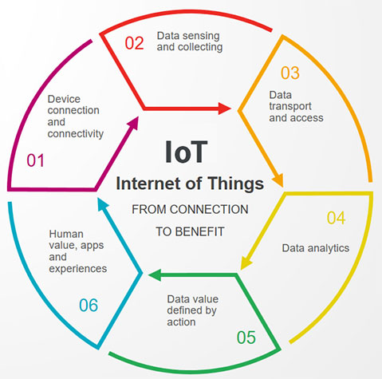
IOT Lifecycle

Slide 3
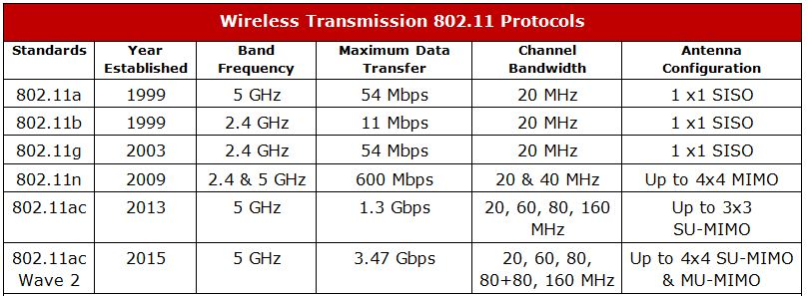
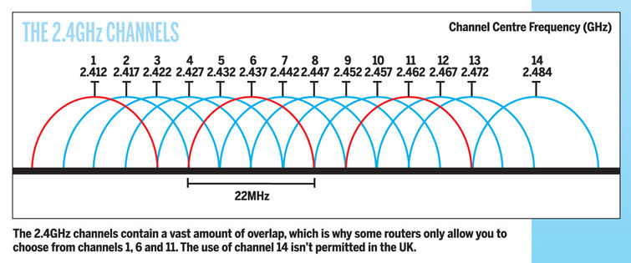
Wi-Fi Standards & Channels

Slide 4
Servers & its Types
WEB Servers [ Apache Http , Xampp , IIS ]
Application Servers [ Tomcat , WebSphere ]
Database Servers [ SQL , NoSQL ]
Mail Servers [IMAP , SMTP ]
FTP Servers
….

Slide 5
API
Web Services API’s
Source-Code API’s
Web Services
REST (Representational State Transfer )
SOAP (Simple Object Access Protocol)
XML-RPC (XML-Remote Procedure Call )
JSON-RPC (JavaScript Object Notation -RPC)

Slide 6
Essentials of Internet
IO Devices [ Sensors, UI ]
Rendering Engine [ Browser etc.]
URL [ Protocol , Host , Domain , Sub-Domain etc. ]
DNS
HTTP, HTTPS [SSL, TLS]
IP Address [IPV4 | IPV6 ]
TCP/ IP Stack
ISP
Router

Slide 7
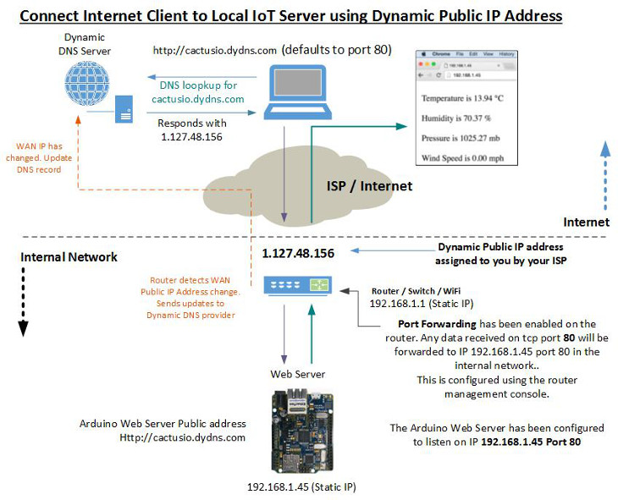
Connecting IOT Devices to Internet
Cellular
Satellite
Wi-Fi
Bluetooth
RFID,NFC, LPWAN, and Ethernet

Slide 8
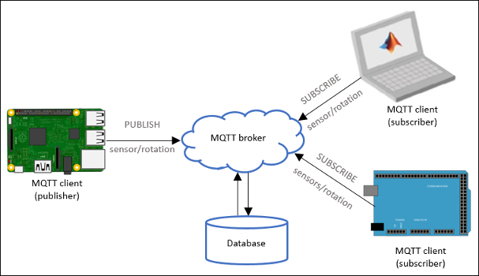
Battle of The Protocols (HTTP vs MQTT)

Slide 9
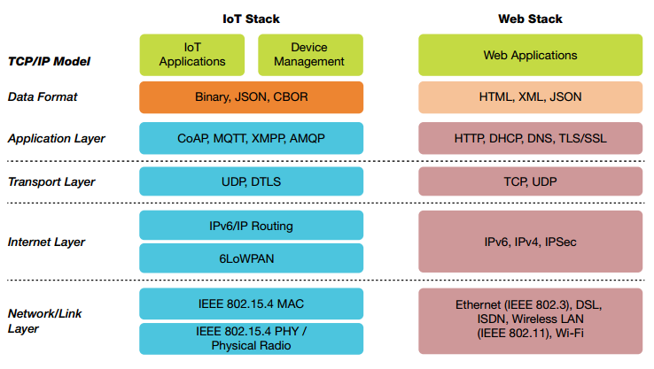
OSI Model

Slide 10
ESP8266 – 12E (Wi-Fi microchip)
- Why ESP8266, why not my PC, smartphone or other Microcontrollers ?
- Other variants / alternatives ?

Slide 11
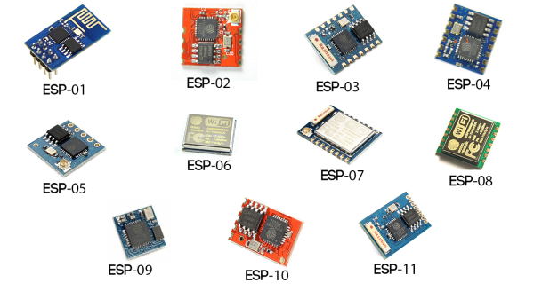
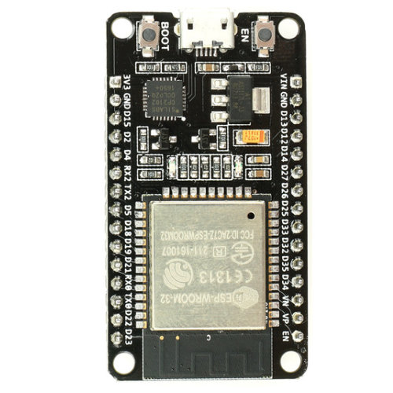
Other Variants*
ESP32

Slide 12
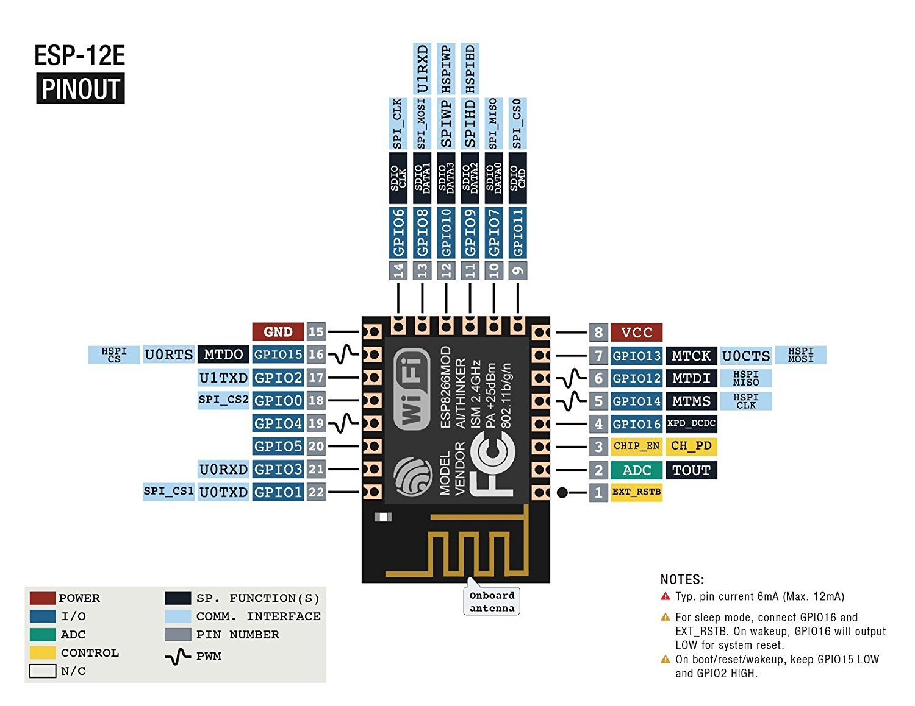
ESP8266-12E [ Datasheet]

Slide 13
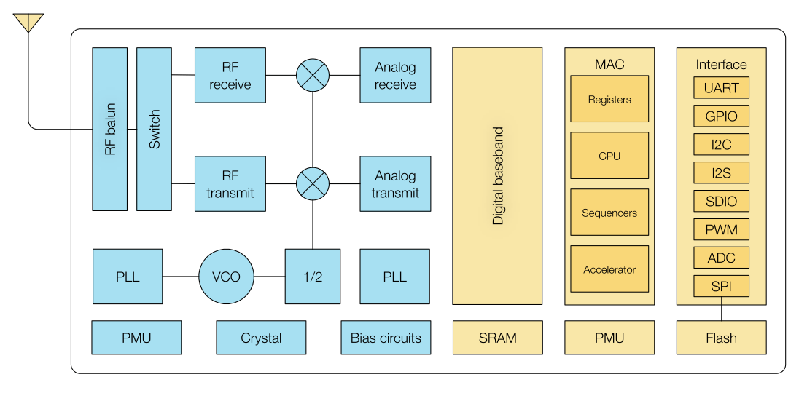
ESP8266-12E (Functional Description)

Slide 14
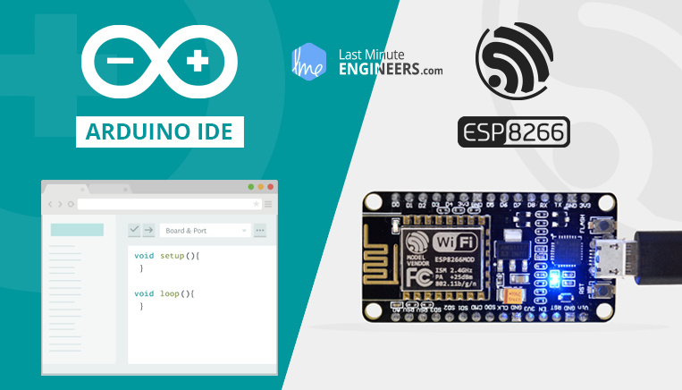
Insight Into ESP8266-12E NodeMCU Features & Using It With Arduino IDE
HatchnHack

Slide 15
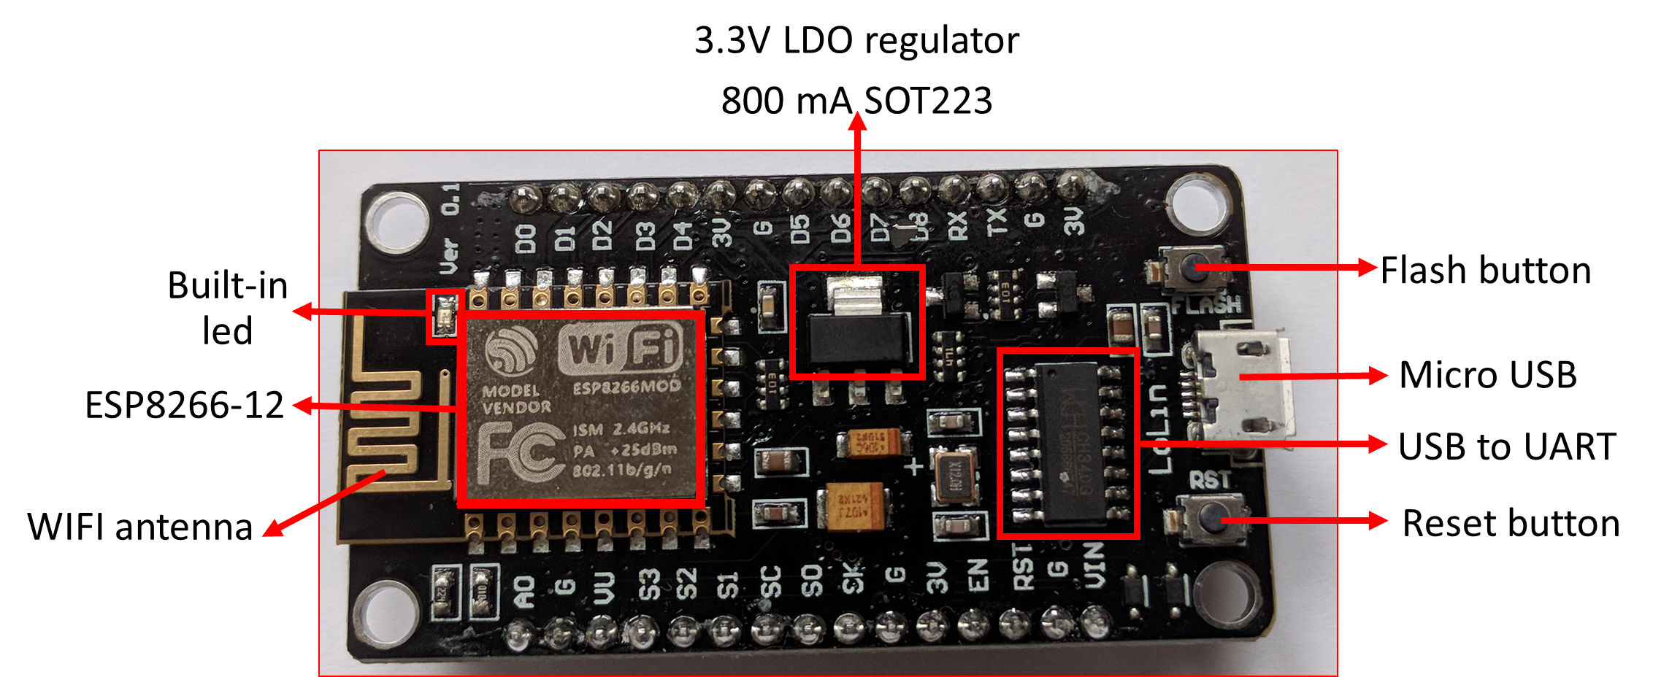
NodeMCU Module

Slide 16
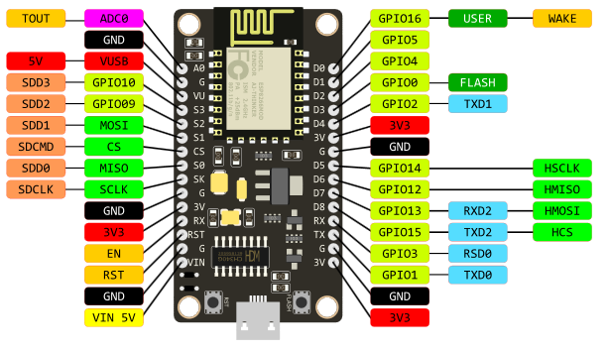
NodeMCU Pinout

Slide 17
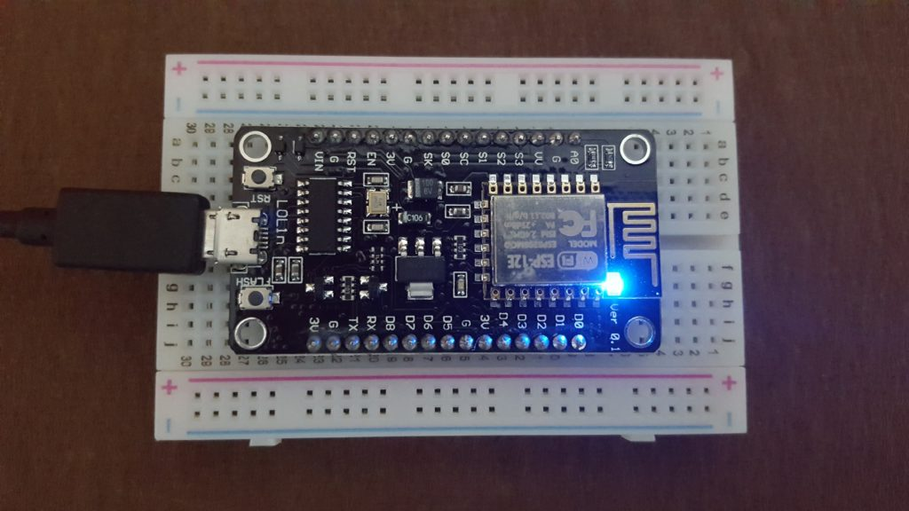
Interfacing With NodeMCU
- Hello World (Blink)

Slide 18
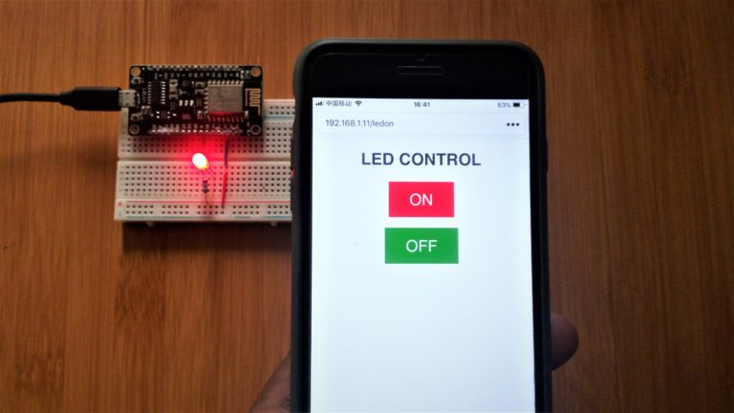
Web Server LED Control

Slide 19
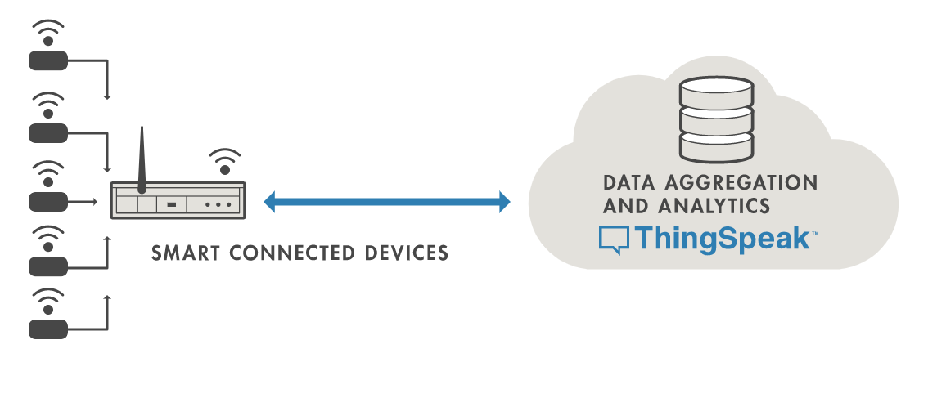
Integrating NodeMCU with ThingSpeak.com

Slide 20



Slide 21
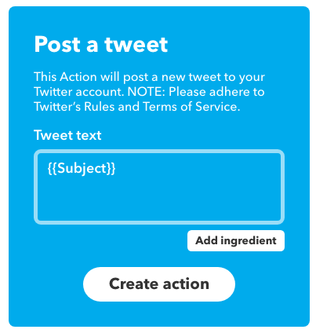

Integrating IFTTT with NodeMCU

Slide 22
Any Questions ?

